Slide 1
Approaches:
Direct Pixel Synthesis
Using Explicit Transformations
Explicit Motion from Content Separation
In the High-level Feature Space
Incorporating Uncertainty
Tools:
GAN
Autoencoder
Challenges of prediction:
Stuck on 4-5 frames, Due to a lot of changes of front view
Auto-encoders tend to remove noise
Contaminations and faults have high frequency
Additional info
Frame T+1
Feature Map Decoder
Frame T+1
Frames
Feature Map Encoder
Anomaly Prediction

Slide 2
Transformation-based Adversarial Video Prediction on Large-Scale Data; Pauline Luc, et al; 2020
Fail Round 1
Benefits:
Use region Transformation kernel which could be useful for our regional faults
Disadvantage:
No comparable results. No comparison with other methods on common dataset
Lack of a clear overview from the network

Slide 3
Improved Conditional VRNNs for Video Prediction; Castrejon, et al; 2019
MAYBE
Pass Round 1
Based on probabilistic models
Benefits:
The best LPIPS on BAIR, but not good SSIM and PSNR
Disadvantages:
Lower PSNR and SSIm on BAIR dataset than Jin [150]
Feed decoder via data from initial state part (may cause problem for feeding Anomaly Detection) => Can we feed features into Anomaly Detection module before frame reconstruction?
Autoencoders have tendency to remove noise and reconstruct clear images. So, it may not generate our images

Slide 4
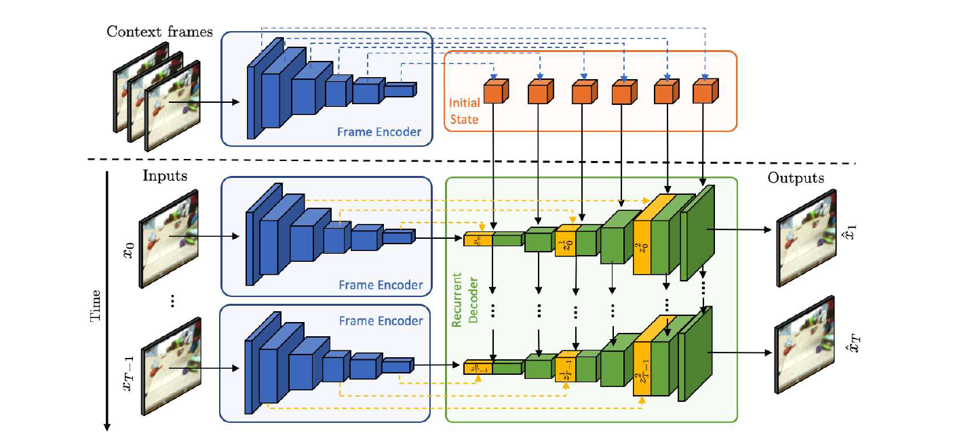
Not good

Slide 5
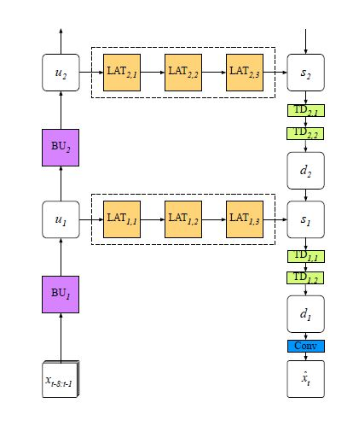
Photo-Realistic Video Prediction on Natural Videos of Largely Changing Frames; Shouno; March 2020
Pass Round 1
Inspired by PredNet
Loss function: adversarial + perceptual
Merge predicted frames with different resolutions in several stages
Benefits:
Seems suitable for cars since it focuses on Car Front view for experiments
LPIPS seems visually important and this network is the state-of-the-art
Drawbacks:
Can we feed features into Anomaly Detection module before frame reconstruction?

Slide 6
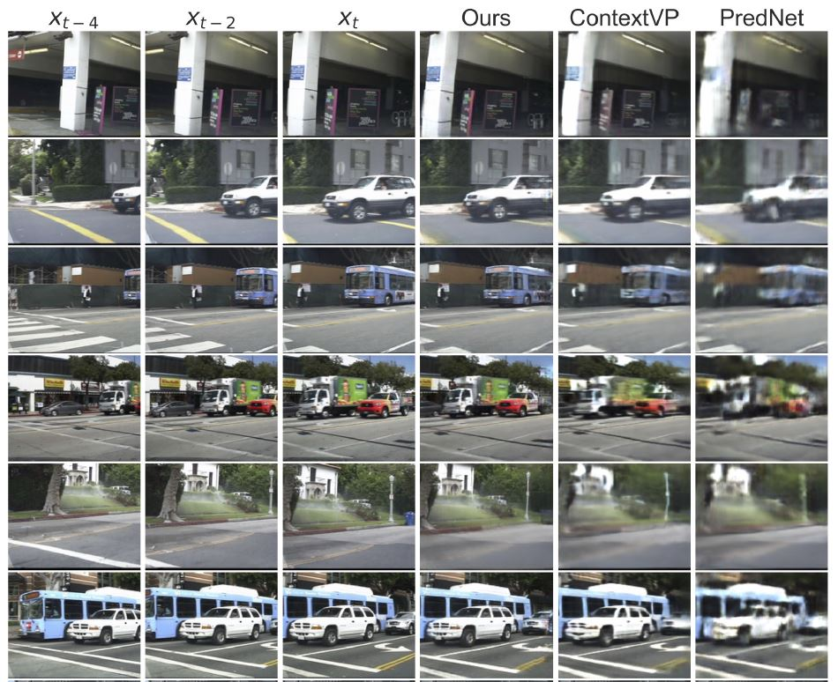
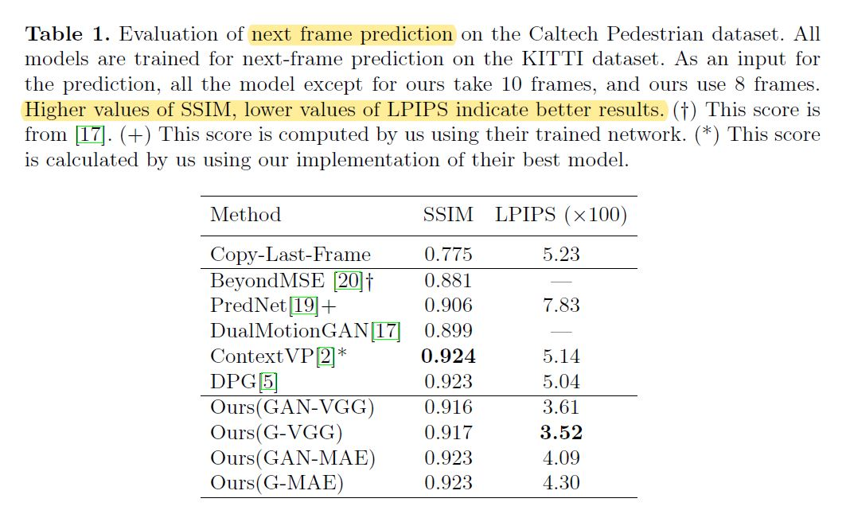
LPIPS seems visually effective and important. LPIPS differs about 2.6 between ContextVP and PredNet, and we can see how better ContextVP is.
G-VGG has lower SSIM but higher LPIPS, and it has reached better visual results. This means that G-VGG is perfect until now!

Slide 7
Exploring Spatial-Temporal Multi-Frequency Analysis for High-Fidelity and Temporal-Consistency Video Prediction; Jin, et al.; 2020
Pass Round 1
Idea: decompose low/high frequencies of Spatial and Temporal information by Wavelet
Comment: Could be useful for our approach since we deal with high frequency points
Attributes:
GAN based
Benefits:
Best choice based on PSNR and SSIM, but ordinary LPIPS
Good qualitative evaluation on KITTI dataset, as well as KTH, BAIR
Use both CNN and LSTM into Anomaly Detection module prior
Features could be fed to decoder stage
The best on Caltech dataset which consists of real-world front view images
Drawback:
Not good at LPIPS, which is seems an important metric
Not very Good qualitative evaluation on Caltech dataset

Slide 8
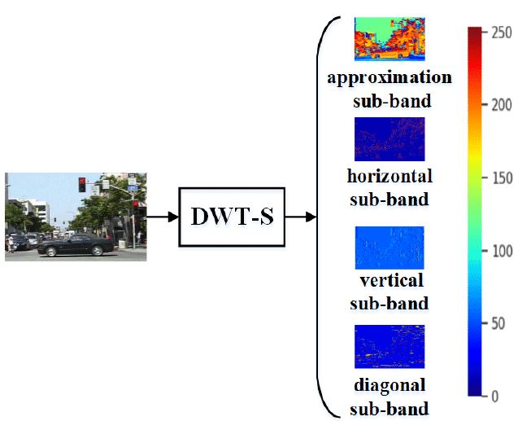
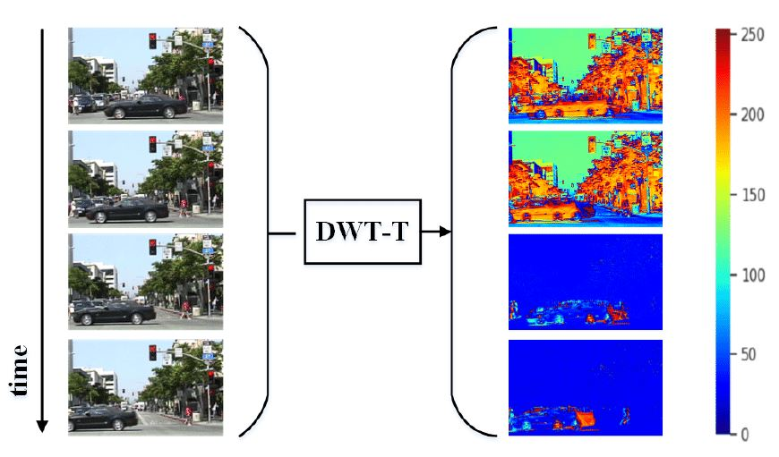

Slide 9
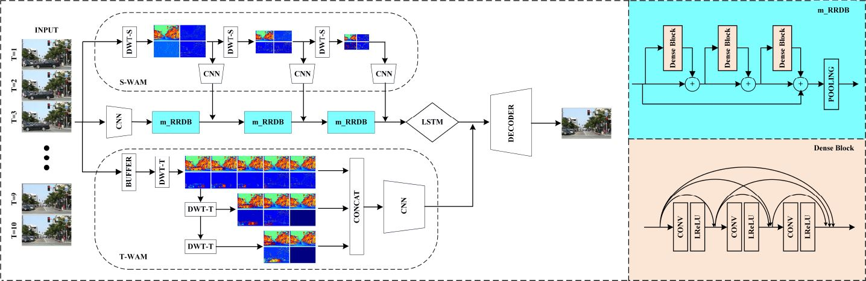

Slide 10
E3d LSTM; Wang; 2019
Pass Round 1
Attributes:
CNN based
Benefits:
Use both 3D-CNN and RNN
Feed feature vectors to Anomaly Detection
Very good SSIM and PSNR
Capture both temporal and spatial info simultaneously
Drawbacks:
Same as auto-encoder
High memory consumption
Out performed by CrevNet

Slide 11
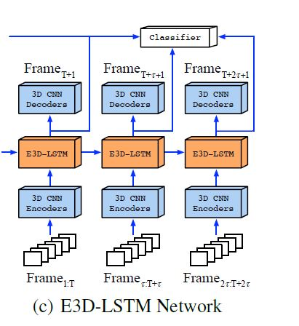

Slide 12
CrevNet: EFFICIENT AND INFORMATION-PRESERVING FUTUR FRAME PREDICTION AND BEYOND; Yu et al; 2020
Pass Round 1
Attributes:
Reversible Autoencoder
Benefits:
Considerable less memory consumption
Both visually and quantitatively, has the best results
Feature map could be fed to Anomaly Detection module
Drawbacks:
Autoencoders have tendency to remove noise and reconstruct clear images. So, it may not generate our images

Slide 13
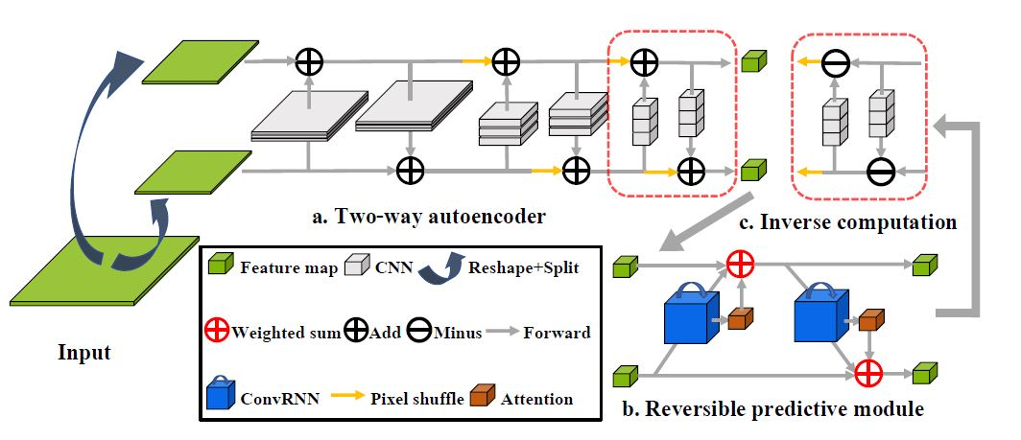

Slide 14
Rank | Paper | Competitive Edge | Important weaknesses
1 | Jin et al, 2020 | Leverage multi-frequency temporal and spatial - GAN
1 | CrevNet, 2020 | Best results | Autoencoder
 | E3D LSTM, 2020 |  | Autoencoder
4 | Shouno 2020 | The best LPIPS | Could net feed feature map reached by encoder

